Slide 1
Tic-Tac-Toe
By Sushant.V

Slide 2
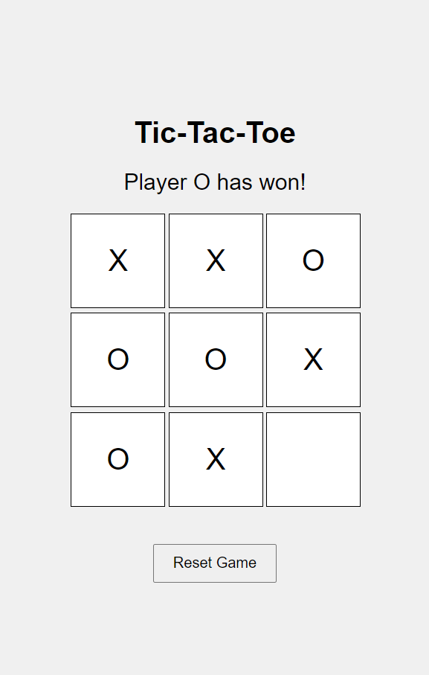
Introduction
What is Tic-Tac-Toe? Briefly explain the game (a simple two-player game where players take turns marking Xs and Os on a 3x3 grid).
State the objective: to align three of your marks (either X or O) in a row, column, or diagonal.

Slide 3
Project Goal: Develop a Tic-Tac-Toe game with a user-friendly interface. Ensure the game is responsive for both desktop and mobile devices. Implement the game logic to allow two players to play and determine the winner.
“
Project Overview
”

Slide 4
Technologies
HTML:
Structure the game interface (grid, buttons, etc.).
CSS:
Style the game board and interface for visual appeal.
Ensure responsive design for different screen sizes.
JavaScript:
Implement the game logic (handling player turns, checking for wins, and declaring results).
Add interactivity (click events, game reset functionality).

Slide 5
Project Objectives
Objective 1:
User-Friendly Interface Design a simple, intuitive interface.
Use CSS to style the game board, ensuring clarity and ease of use.
Cloud-based opportunities
Iterative approaches to corporate strategy
Establish a management framework from the inside

Slide 6
Game Logic in JavaScript
Implement player turn management.
Detect win conditions (rows, columns, diagonals).
Handle game state (e.g., draw, reset).
Responsiveness
Ensure the game layout adapts to different screen sizes.
Use media queries and flexible units in CSS.

Slide 7
Challenges & Solutions
Challenge 1
Challenge 2:
Challenge 3
Handling edge cases (e.g., a
draw)
.Solution: Implement robust game state management in JavaScript.
Ensuring responsiveness.
Solution: Use flexible CSS units and media queries.
Maintaining code quality
.Solution: Write modular and reusable JavaScript functions.

Slide 8
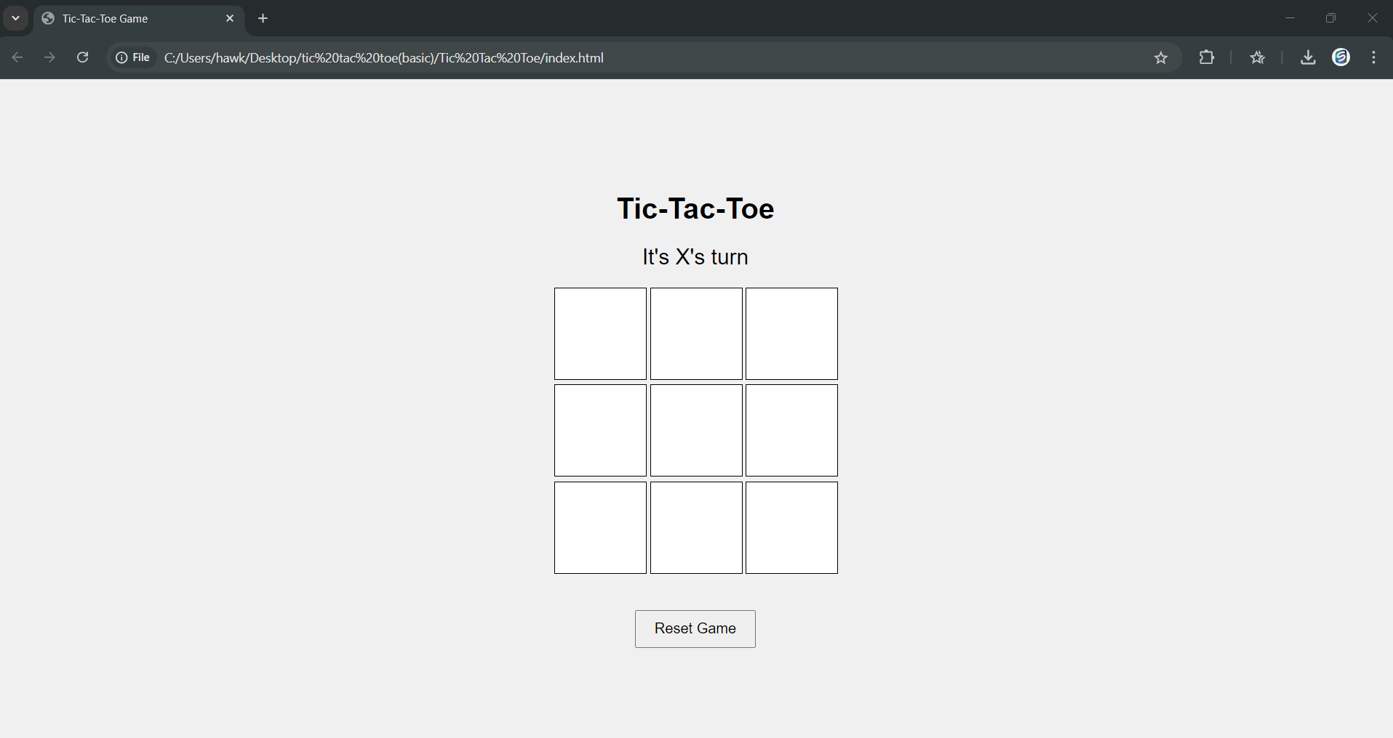
Project demo

Slide 9


Slide 10
Conclusion
Recap of Objectives: User-friendly design. Efficient game logic. Responsive gameplay . Final Thoughts: Importance of combining design and functionality. How this project demonstrates core web development skills.

Slide 11
Thank you

